Slide 1
Inside
Sales-Corporate Marketing
Date: 25th July 2024

Slide 2
Salesperson vs. Leads 2022
1. Top Performers:
Sushant Manerikar leads by a significant margin with 163 leads.
Dareen Monteiro follows with 146 leads.
Mansoor Syed Ahmed is third with 102 leads.
2. Distribution of Leads:
The top three performers (Sushant Manerikar, Dareen Monteiro, and Mansoor Syed Ahmed) collectively account for 411 leads, which is nearly 47% of the total 880 leads.
The rest of the salespeople share the remaining 469 leads, indicating a significant concentration of leads among the top performers.

Slide 3
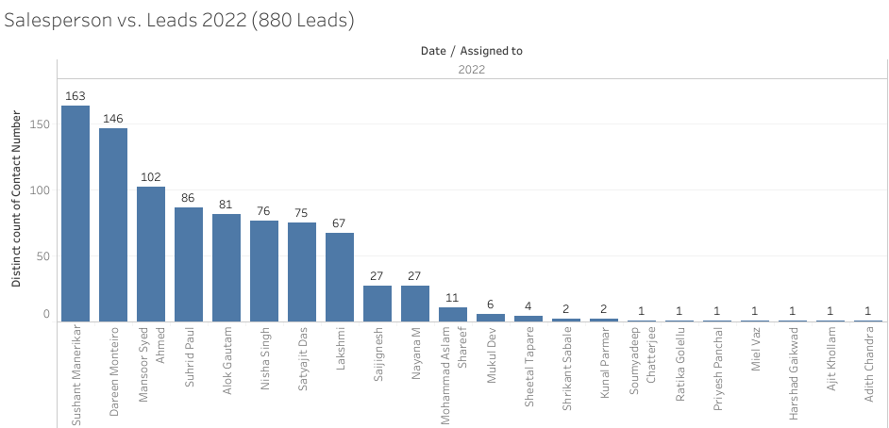

Slide 4
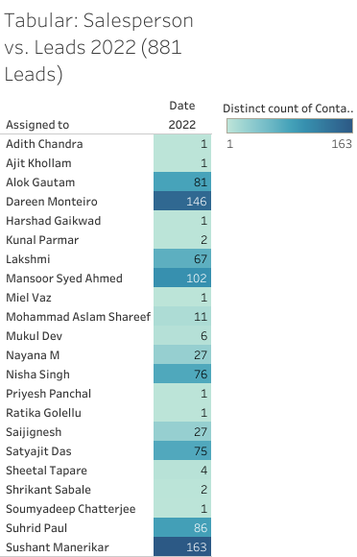

Slide 5
Salesperson vs. Leads 2023
1. Top Performers:
Aparna leads by a significant margin with 269 leads.
Swati follows with 252 leads.
Lakshmi is third with 169 leads.
2. Distribution of Leads:
The top three performers (Aparna, Swati, Lakshmi) collectively account for 690 leads, which is nearly 29% of the total 2411 leads.
The rest of the salespeople share the remaining 1721 leads, indicating contribution is evenly distributed still this year more Salespersons than previous year.

Slide 6
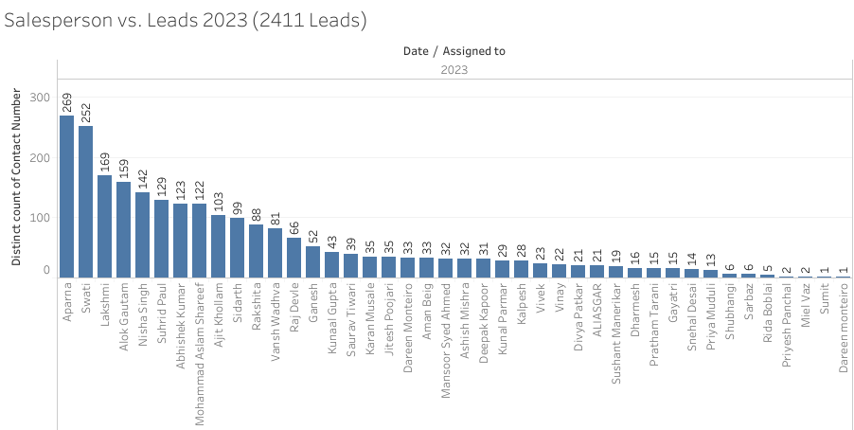

Slide 7
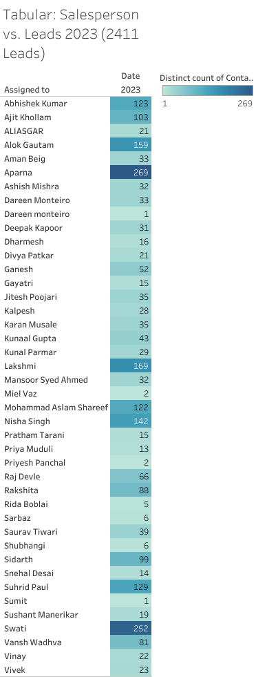

Slide 8
Salesperson vs. Leads 2024
1. Top Performers:
Saurav Tiwari leads by a significant margin with 198 leads.
Dharnesh follows with 178 leads.
Alok Gautam is third with 176 leads.
2. Distribution of Leads:
The top three performers (Saurav Tiwari, Dharmesh and Alok Gautam) collectively account for 552 leads, which is nearly 26% of the total 2132 leads.
The rest of the salespeople share the remaining 1580 leads, indicating a significant concentration of leads among the top performers.

Slide 9
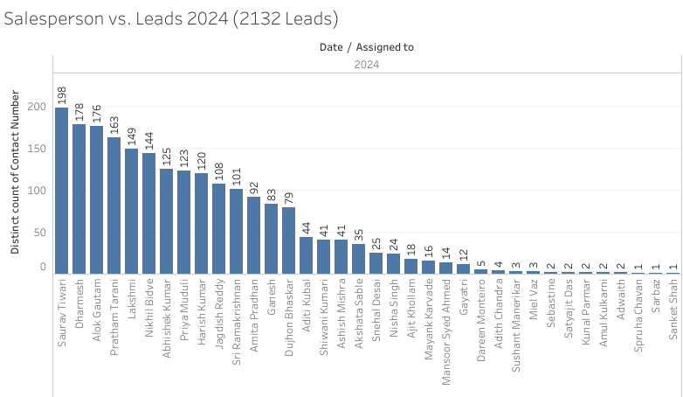

Slide 10
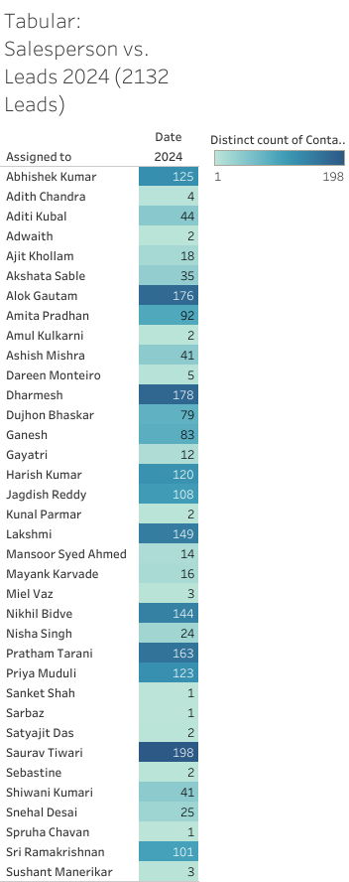

Slide 11
Lead Source vs. Leads
Top Lead Sources:
PPC is the highest contributor with 1705 leads.
Lusha Leads follows with 1251 leads.
Raw Leads also contributes significantly with 1,084 leads.
Other Notable Lead Sources:
SEO with 555 leads.
Lead Platform with 307 leads.
Paid Campaign with 253 leads.

Slide 12
3. Insights for Improvement:
Focus on optimizing the top lead sources, such as PPC and Lusha Leads, since they are already performing well.
Investigate the potential of moderate contributors like SEO and Paid Campaigns to see if their performance can be further enhanced.
Reevaluate or potentially discontinue low-performing sources to allocate resources more efficiently.
4. Diversification and Strategy:
While it's beneficial to have a diversified range of lead sources, the data indicates a heavy reliance on a few top sources.
Exploring new strategies for lower and moderate performing sources could help in reducing dependency on top sources.

Slide 13
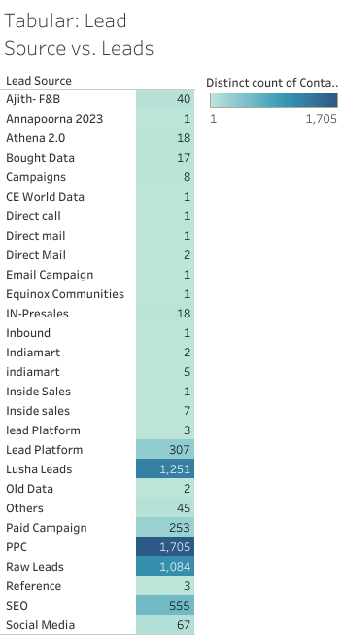
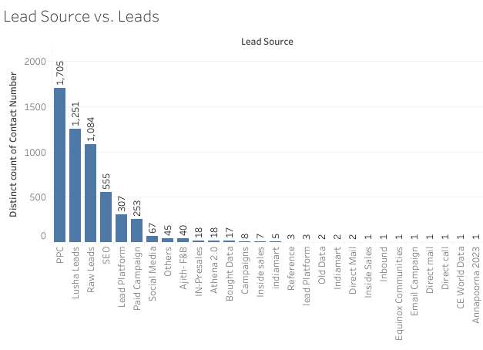

Slide 14
Leads vs. Month-Year
Seasonal Trends:
There are clear spikes in lead counts during certain months, notably in April, May, and June across the years.
The highest spikes are seen in May 2024 (585 leads), April 2024 (574 leads), February 2023 (385 leads) and March 2023 (548 leads).
Annual Patterns:
Each year shows a peak in leads during the first half, particularly around Q1 (April to June).
The lead counts tend to drop significantly in the second half of each year, with noticeable decreases around January, February, March and July onwards for current performing year.
Yearly Comparisons:
2022 shows the highest variability with multiple peaks (March, April, June).
2023 exhibits a smoother curve compared to 2022, but still maintains high peaks in April, June and July.

Slide 15
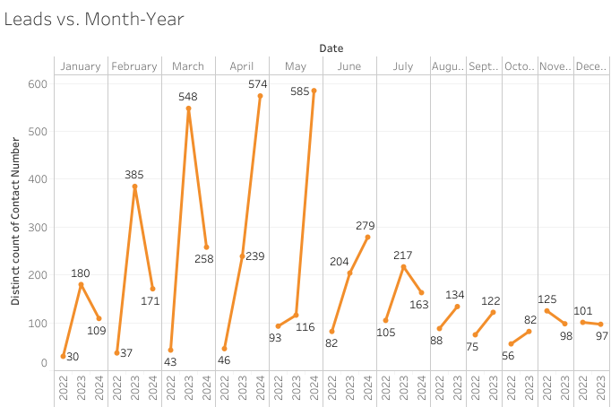

Slide 16
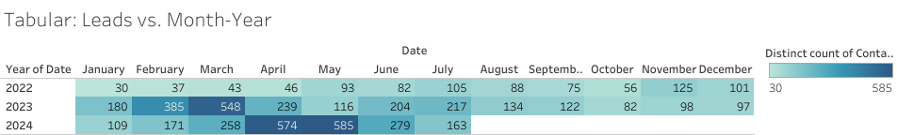

Slide 17
Region vs. Leads
The Number of Leads in each Regions:
The region with the most leads is West, South, North and Environment with 1,672 leads, 1544 leads, 1109 leads and 944 leads, respectively.
The region with the least leads is PCVT with 19 leads.
The total number of leads is 5424 leads.
Top 3 Regions for leads comprises 79% of Total Leads.

Slide 18
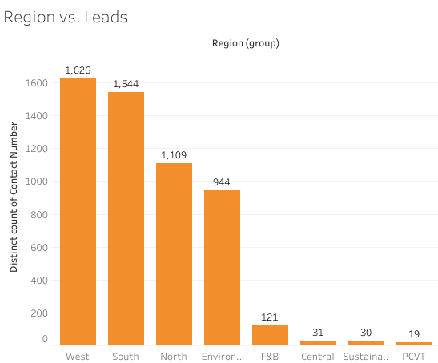
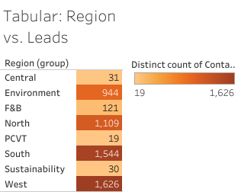

Slide 19

By Abhinav Patil Sales Coordinator (Data Analyst)

